Slide 1
Adobe Illustrator Basics
Chris Maxwell
FIT 1012
September 13 2009

Slide 2
Basic Tools
Brush:
The brush is a simple yet important tool. It's basic function is to freely draw lines on the artboard. The width, pattern, and many other options can be customized.
Pen: The pen tool is like the brush in many ways but instead of clicking and dragging the line anywhere, the user clicks one point, then again at another point. A line forms between the two points and it can be curved if desired. Selection: If you need more space to work in, this tool allows the user to select previously drawn elements and move them anywhere no the screen. This helps with alignment, layout, and composition.
Basic Shapes:
This tool can create perfect squares, circles, stars, and other simple shapes of any size.

Slide 3
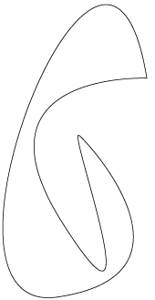
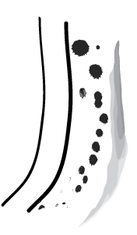
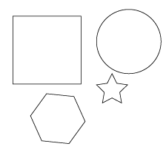
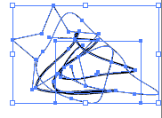
Examples:
Brush
Pen
Selection
Basic Shapes

Slide 4
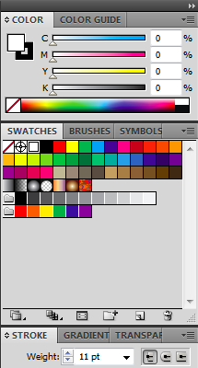
Basic Settings
Stroke
Weight: This defines how wide a segment or “path” will be. The unit of measure is in pixels.
Next to the weight there are 3 smaller icons. These determine what the end of a segment will look like: rounded, short square, or projected square.
Color
Swatches: This is a palette of pre-defined colors for quick reference and use. Once one is selected, it will be shown in detail with the sliders. It can be changed to the exact color the user wants by moving the sliders.
Gradient: A gradient is a transition from one color to another (or more).

